Slide 1
What - M365 Copilot agent?
A simple mental model for non-technical users
An agent is a focused version of Copilot designed for a specific task, process, or knowledge area.
1. It knows the context
2. It follows instructions
3. It can help act
It can be connected to approved knowledge sources such as files, SharePoint content, or connectors so answers stay grounded.
You define how it should behave, what style it should use, and what tasks it should focus on.
Depending on how it is built, it can support activities such as retrieving information, summarizing, or triggering actions.
In one line: Chat answers broadly. Agents help deeply within a defined workflow.
Notes:
Speaker notes: [Sources] Microsoft Learn: Agents extend Copilot with specialized assistants, organizational knowledge and automation (turn1search6, turn1search42, turn1search47). Microsoft Support: Agents connect to organizational knowledge and data sources and automate business processes (turn1search61). [/Sources]

Slide 2
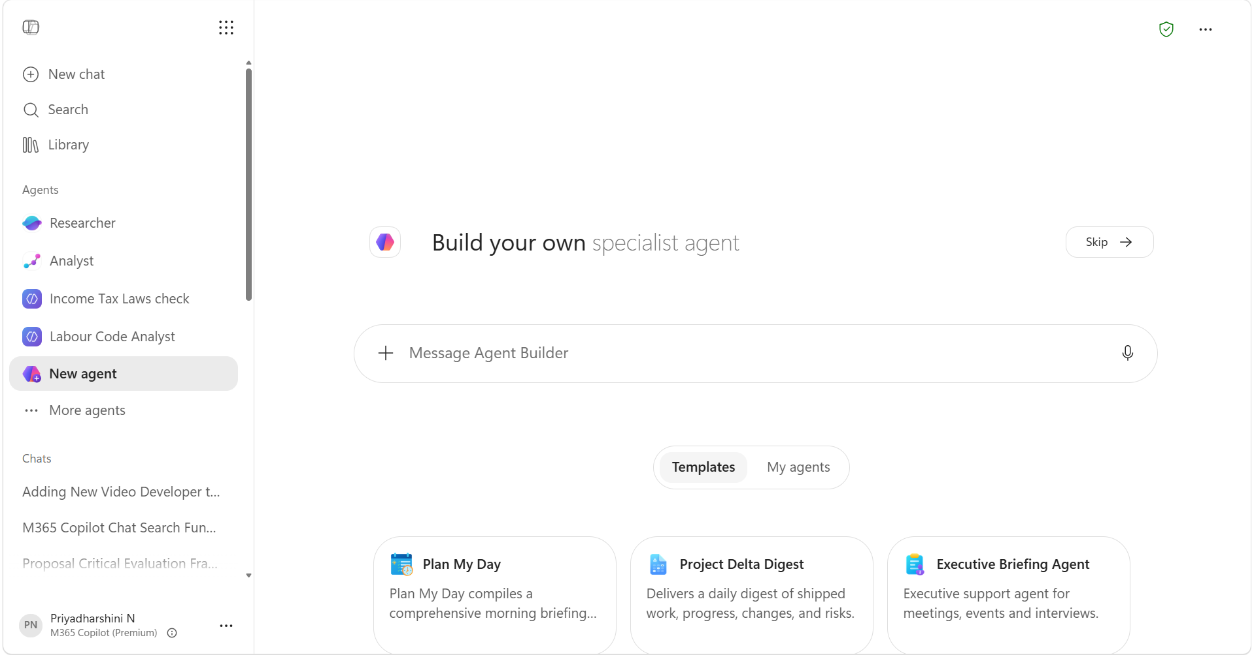
Helps you find, organize, and summarize information on a topic into an easy-to-read report.
Or skip to build your own Agent
Analyzes the data you provide and highlights trends, insights, comparisons, and forecasts.
Either you could describe your agent here
You could upload your work content here
All your agents will be listed here
Sample Agent Templates to build
M365 Copilot Agent UI after clicking on New Agent
This is an Agent Store where you can find agents built by Microsoft, your org. and by you

Slide 3
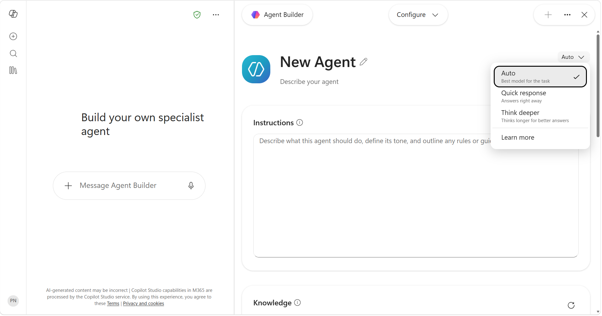
How - M365 Copilot agent?
Choose your LLM Model
Name your Agent
Provide Instructions to precisely follow and build an Agent

Slide 4
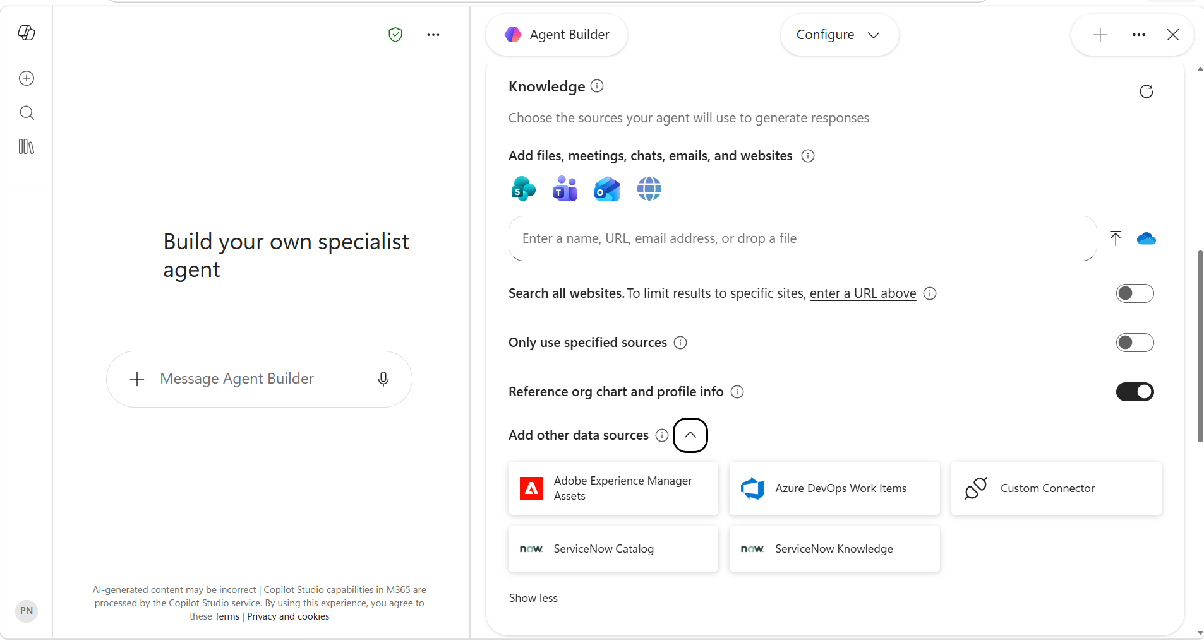
How - M365 Copilot agent?
Add you knowledge source
Restrict your agent's overall scope when accuracy is critical.
Use org chart and profile data to answer people questions.
Add data sources enabled by your org.

Slide 5
The journey - Build your own agent:
1
2
3
4
5
Start
Describe
Configure
Test
Create / Share
Open M365 Copilot and select New Agent.
Provide Name and Description to your Copilot Agent.
Add instructions, knowledge, and suggested prompts.
Ask sample questions and refine behavior.
Use it yourself or share if allowed.
Keep the build purposeful: one agent, one clear workflow, trusted sources, and a human review step.
Notes:
Speaker notes: [Sources] Microsoft Support: Build your agent using a prompt or template, then configure and create (turn1search60). Microsoft Learn: Declarative agents can include instructions, custom knowledge, and actions (turn1search47). [/Sources]

